Slide 1
Local Field Potential Recordings and Pre-processing
Esther Florin

Slide 2
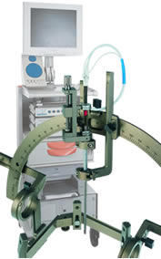
Intraoperative Recording System
ISIS MER-System with up to 5 combined micro-/ macroelectrodes
Simultaneous recording of EMGs from the opposite side compared to the micro-recordings

Slide 3
Configuration of electrodes

Slide 4
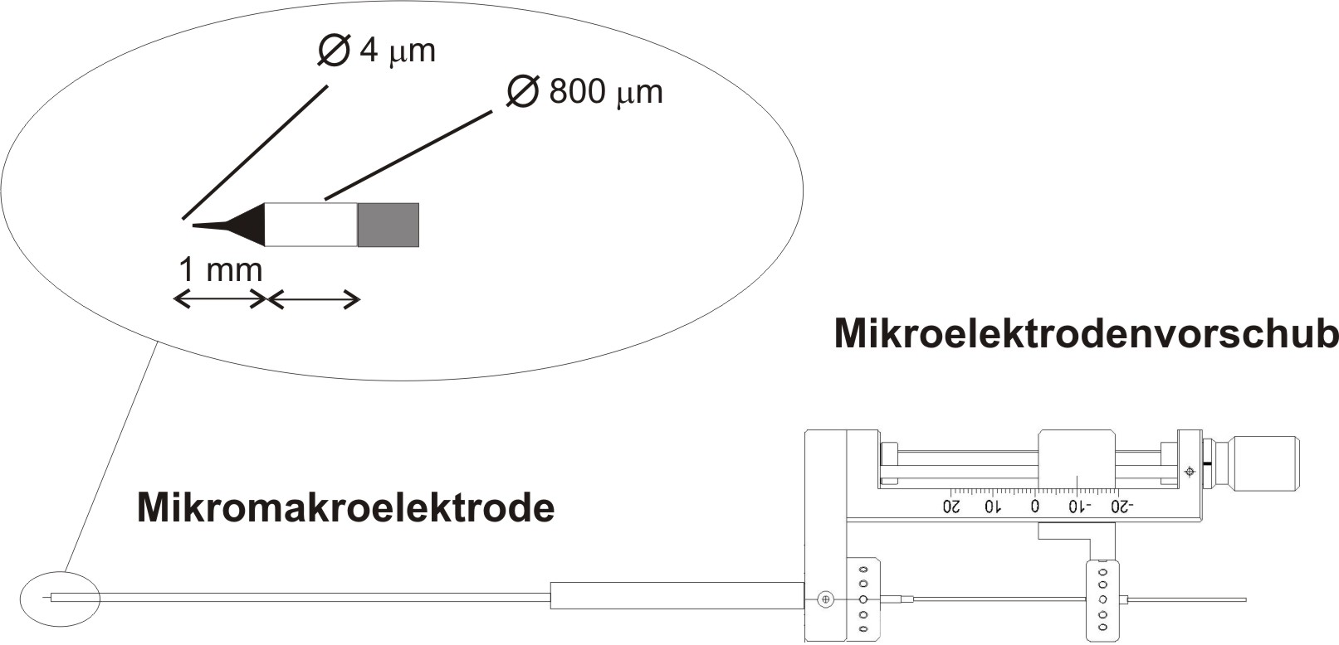
Electrode specification
Macroelectrode
Impedance 1 kΩ
LFP and EMG band- pass filtered 0.5 Hz -1 kHz
Preamplified with gains of 2000 and 200
Sampling rate 2.5 kHz with a resolution of 12 bits
Microelectrode
Tungsten Tip
Impedance 1-2 MΩ
Filtered 250 Hz -10 kHz
Preamplified by a factor of 20,000

Slide 5
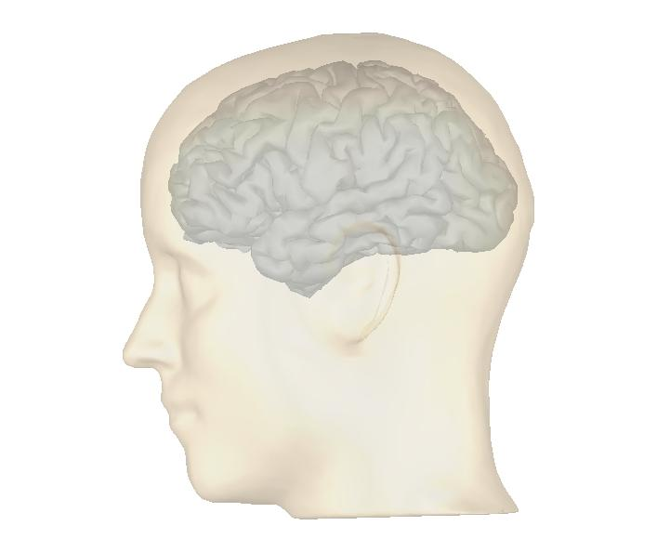
Recording in the STN
up to 5 parallel electrodes

Slide 6
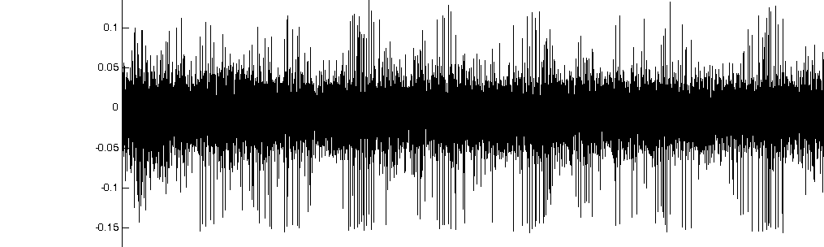
Microelectrode recording
Non-STN
1 sec
STN
Identification of typical discharge pattern
Identification of termor cells, touch sensitive cells
Determintation of the entry into the STN (in the case of Parkinson‘s disease)

Slide 7
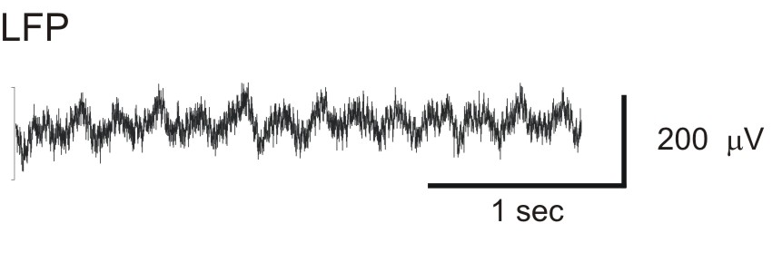
Macroelectrode Recording
Local field potential (LFP)
Summation of excitatory and inhibitory postsynaptic potentials of various neurons
Recording from tissue surroundig the electrode
Up to 250 μm around the electrode (Katzner et al. 2009)
But in our setting the electrode is larger → likely larger recording diameter

Slide 8
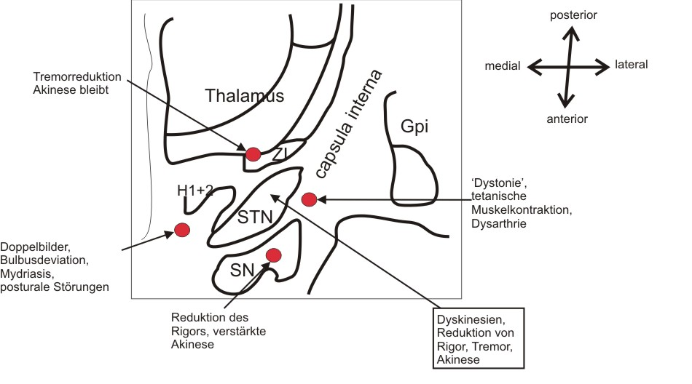
Intraoperative test stimulation
Krauss & Volkmann,
Tiefe Hirnstimulation, 2004

Slide 9
Final Medtronic Elektrode
Resistance < 100 Ω
Platinum-iridium

Slide 10
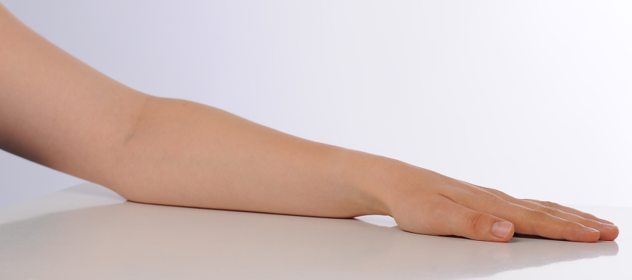
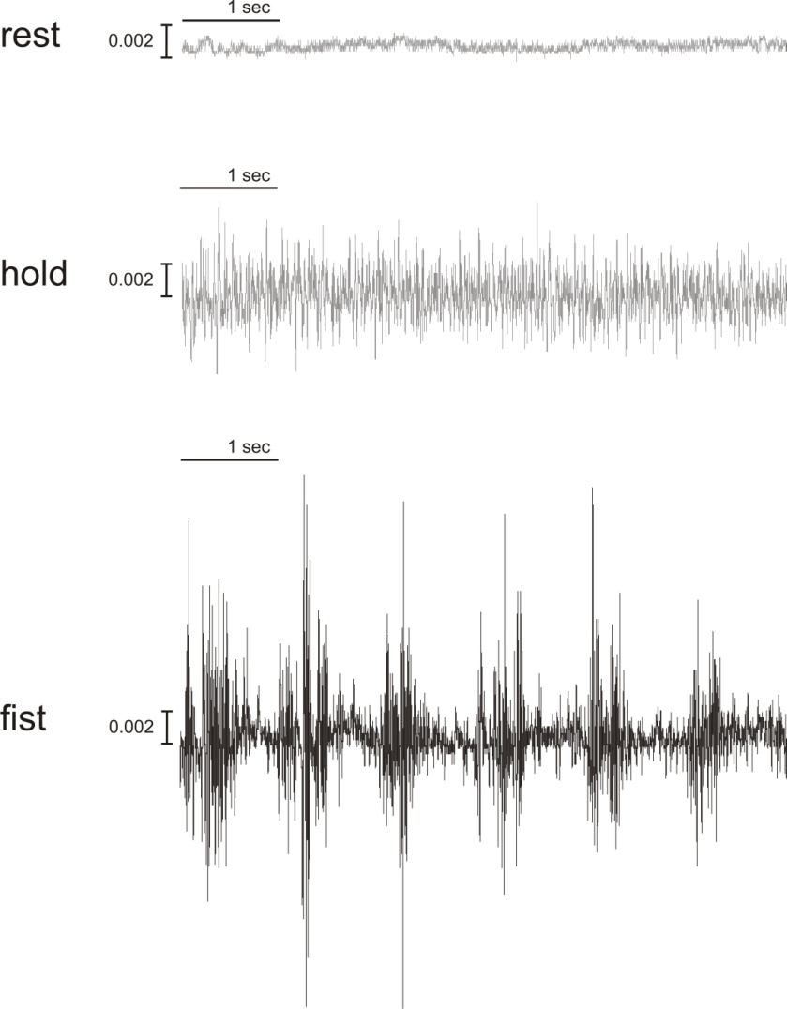
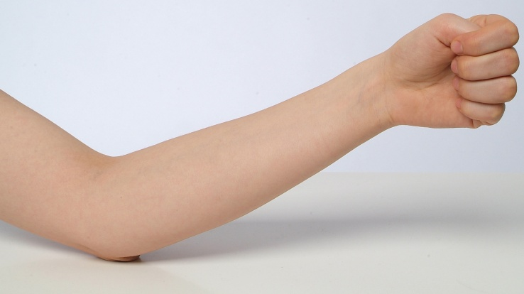
EMG Activity
Two surface electrodes
Recording of potential difference
Reference placed on silent area
Active EMG is placed over muscle

Slide 11
Processing of the data after the recording
Visual artefact correction
High-pass fikter (1Hz or 2 Hz)
50 Hz notch filter
Low-pass filter in some cases
Filter specifications: usually Butterworth with order 4 and phase-neutral
Downsampling of the data (to 250 Hz) for Fourier analysis, not for AR modeling

Slide 12
Power- and Coherence

Slide 13
EEG

Slide 14
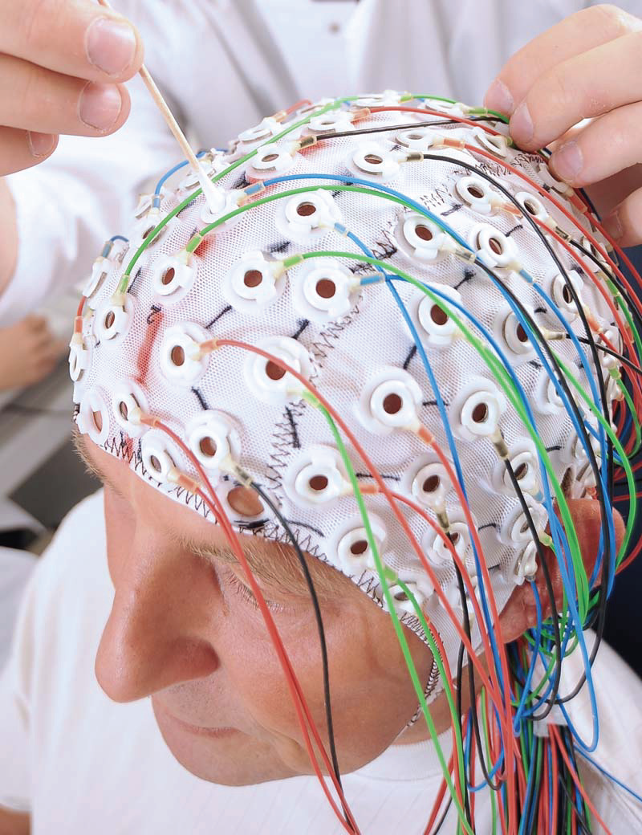
EEG
128 electrodes
Contact through conductive gel/paste
Research: within electrically shielded room

Slide 15
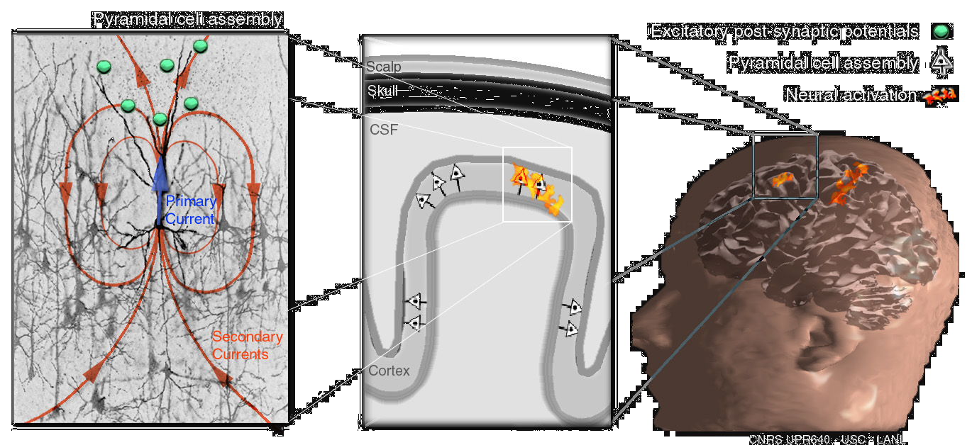
Signals measured by the EEG
scales:
micro
meso
macro
Baillet et al., IEEE Sig. Proc. Mag., 2001
Notes:
Excitatory synaptic input acivates the dendrites
To be picked up with EEG thousands of neurons have to be activated simultaneously
→ Summation of synchronous activity of macrocolumns of thousans of spatially organized large pyramidal neurons

Slide 16
Cleaning of the data
Marking contaminated parts as bad
Eye-blink, cardiac, and saccade: correction through ICA or SSP
Excluding sensors

Slide 17
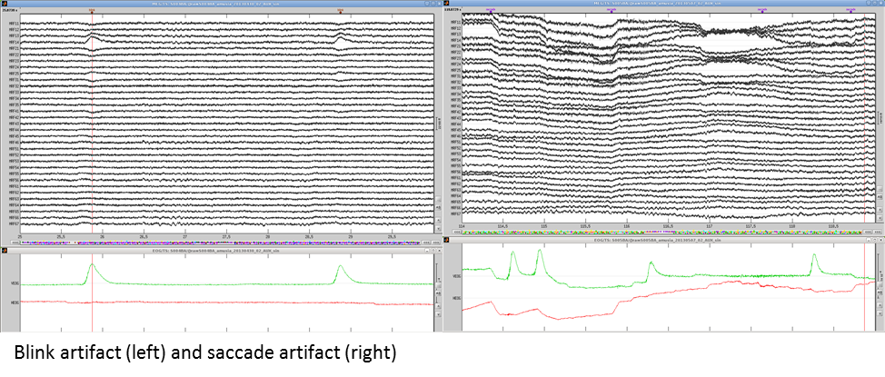
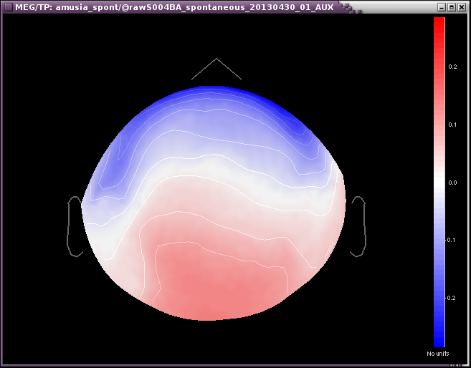
Eye Movements

Slide 18
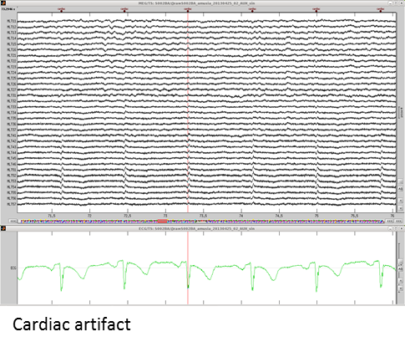
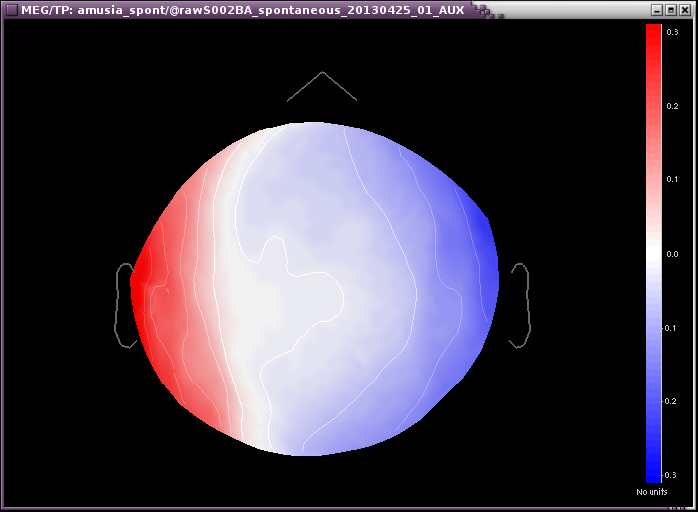
Cardiac and muscle artefacts

Slide 19
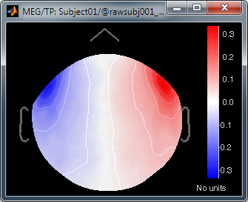
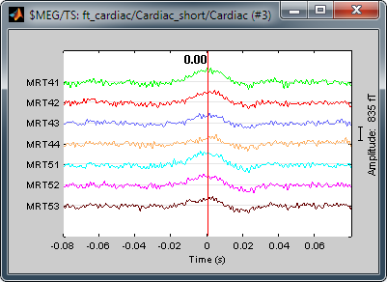
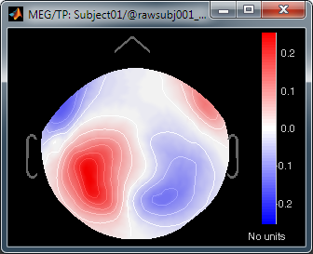
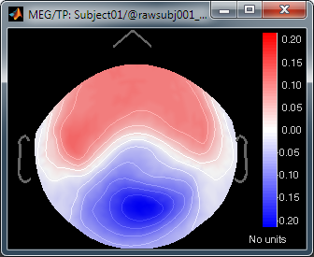
Pre-processing Cleaning
Signal-Space Projection (SSP)
Spatial components
Detect artifacts
Concatenate epochs
Select components
Compute projectors (linear operator)
Apply to EEG/MEG
PCA

Slide 20
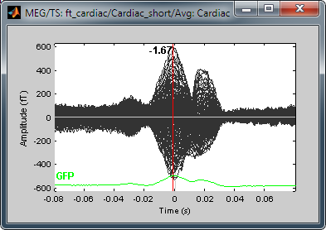
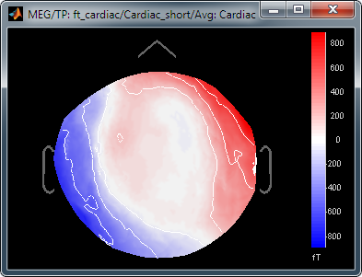
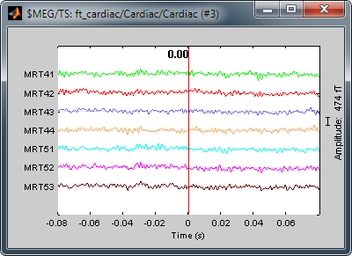
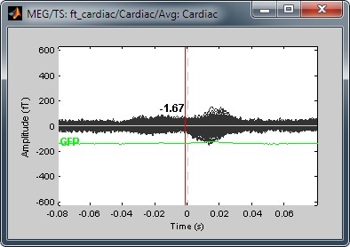
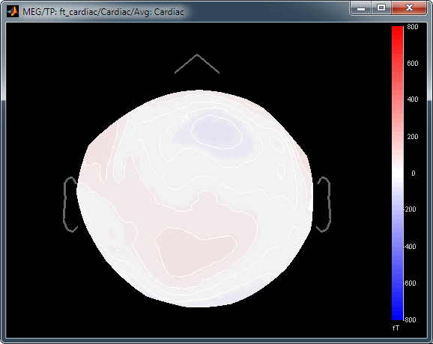
Pre-processing Cleaning
Example: Cardiac artifact
Original
SSP

Slide 21
Thank you!

Slide 22
Technical Details
Macroelectrode
diameter macroelectrode 800 μm
impedance 1 k Ω
LFP and EMG signals band- pass filtered 0.5 Hz -1 kHz
Preamplified with gains of 2000 and 200, respectively
Sampling rate 2.5 kHz with a resolution of 12 bits.
Microelectrode
Tip is made of tungsten
Diameter 4 μm
Impedance 1–2 MΩ
Filtered 250 Hz -10 kHz
Preamplified by a factor of 20,000

